Slide 1

Upstream Prevention in Practice
How community collaboration and early intervention support vulnerable youth
Community Social Planning Council
June 25th, 2026
Notes:
CSPC:
How we identify emerging needs
MLAT and regional collaboration
Examples of upstream prevention in practice
Experience: Community-based service delivery, tying front-line and systems experience

Slide 2
What is the Community Social Planning Council?
Community-Based Research
Service Delivery
Collaborative, Regional Action
Identify emerging needs and service gaps
Understand community priorities
Informed evidence-based recommendations
Address immediate community needs
Identify barriers to accessing services
Pilot or strengthen responses to unmet need
Convene partners across sectors
Leverage long-standing community relationships
Strengthen regional coordination
Notes:
Nearly 90 years of work in CRD
Mission has evolved, focus is still to support community wellbeing
3 areas of work:
Community-based research and evaluation
Direct Services
Regional Collaboration
Historically helped establish:
Bridges for Women
United Way
Regional reach
Look for patterns (emerging issues, service gaps, opportunities)
Responses vary:
Convene partners
Community engagement
Recommendations
Strengthen existing responses

Slide 3
Why Upstream Prevention?
​
What happens before a young person becomes involved with the justice system?
​Possible contributing factors:
Housing instability
Poverty
Family conflict
Mental health challenges
Difficulty navigating services
Fragmented systems
Notes:
Justice is rarely the first challenge
Challenges overlap
Compounding barriers > each challenge makes the next harder
Additional vulnerabilities
Example: LGBTQ2S+ youth, family rejection, housing instability, reduced impact of protective factors
Challenges cross housing, health, education and justice
Opportunities for earlier intervention
Upstream prevention > recognize barriers early and respond before they become more complex

Slide 4
Housing Stability
Greater Victoria Rent Bank
​
The challenge: A temporary financial crisis can quickly lead to eviction, homelessness, family instability, and school disruption
Reasons for application can include:
Loss of employment or reduced hours
Unexpected medical or family expenses
Relationship breakdown
Delays in receiving income or benefits
Experiences of violence
Our Response:
Interest-free loans, grants, and ongoing rental subsidies
Referrals to community resources
Support in a time of crisis
Notes:
The Rent Bank is a direct service program that supports low- to moderate-income households at risk of eviction through financial assistance and referral
Every application begins with a conversation > why they’re here, what’s contributing, what supports may help
Common reasons (can happen to many of us):
Job loss
Unexpected expense
Relationship breakdown
Case managers
Comprehensive assessment
Stay current on community services
Direct connections wherever possible
Conversations, engagement, program data reveal trends and identify service gaps
E.g., Increase in IPV, convening violence prevention organizations
Front line work informs community responses

Slide 5
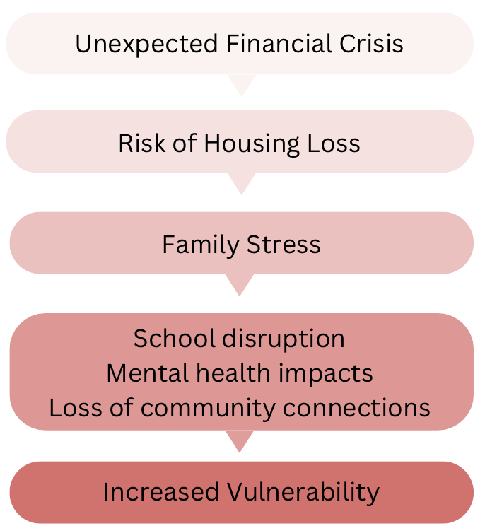
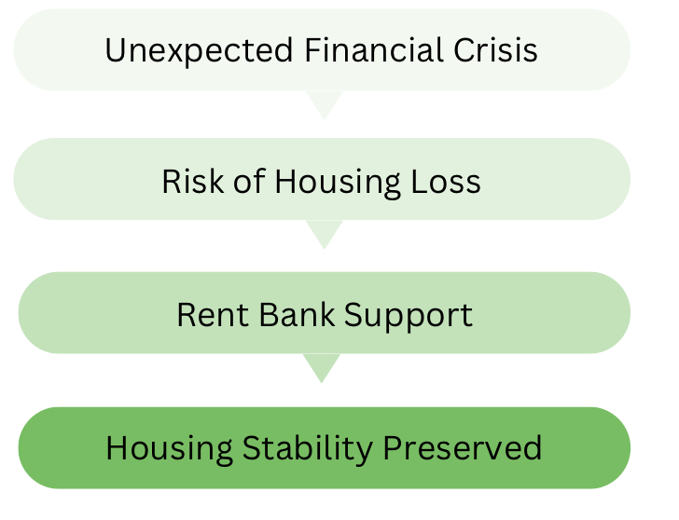
Possible Trajectories
Notes:
Walk through graphics
Left: Housing instability is more than housing > stress, school, employment, connection
Right: Early intervention interrupts progression
Not specifically a CYF program, but stable housing as a strong protective factor for CYF

Slide 6
MLAT: Strengthening Regional Collaboration
Regional Partners:
Colwood | Langford | Sooke | Metchosin | Highlands | SD 62 | Island Health | The Village Initiative
Together, we’re working to:
Improve access to services
Strengthen collaboration across sectors
Identify and act on shared priorities
Reduce duplication and service gaps
Measure progress and shared outcomes
Notes:
What do we do with what we learn?
Challenges can’t be solved by one organization or system
Often an issue with coordination, not lack of services
MLAT:
Recognized by 5 West Shore/Sooke municipalities
Challenges don’t stop at municipal boundaries
Families experience services regionally
My role (use slide)
Regional perspective
Families access services across municipalities
Regional lens identifies shared priorities
Better coordinated responses
Data and evaluation
Regional data tells fuller story
Shared measurement, accountability
Regional baseline:
Island Health Population and Public Health
McCreary Adolescent Health Survey (via SD62)
Other regional data
Shared indicators, partner data, identify early trends, measure outcomes, guide future decisions
Goal: better coordination and outcomes, easier systems to navigate

Slide 7
Prevention Starts Before Crisis
This means:
Listening to community needs
Early identification of emerging issues
Collaboration across sectors
Coordinated responses
Shared accountability
Communities are stronger when services are connected and working together
Notes:
Closing
Upstream prevention looks different in different settings
Common thread: identify needs early and respond before problems become more complex
Early intervention is often less intensive and expensive than reactive services
Every organization, system, etc. sees one part of the picture, collaboration creates a more complete understanding
Municipal leaders and community partners all have a role
Better outcomes through shared learning, coordination, common priorities

Slide 8
THANK YOU

