Slide 1

November 23, 2023
Victoria Family Court Youth Justice Committee
Cindy Andrew, Director, Community Partnerships

Slide 2

Once upon time …
Common concerns and goals
Silos prevailed
Population growing exponentially
Needs were increasing; resources were not
School district identified health promoting schools as a focus area
Growing appetite and action on deepening cross-sectoral efforts

Slide 3

Network Initiated: building on our strengths
SD62 and Island Health started a conversation with community partners, recognizing that the health and well being of children, youth and families are best supported through an all-hands-on-deck approach – a village.

Slide 4
Advanced Ed
Island Health
Municipalities
Non-profits
MCFD
Funders
Police
Business
Indigenous Service Agencies
School District
Purpose:
To engage community and system leaders working in the Sooke West Shore region in a collaborative structure that can identify and address key community issues facing children, youth and adults through coordinated responses.
Notes:
For list of current Village members please see https://thevillageinitiative.ca/our-network/.

Slide 5
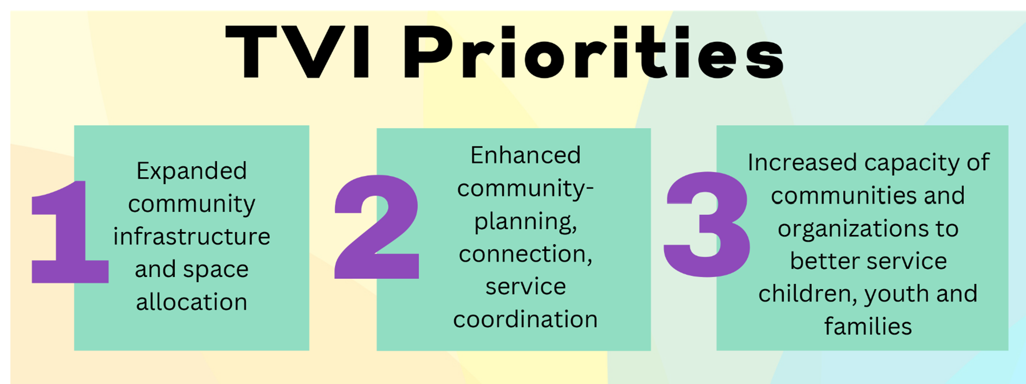
Notes:
More on TVI priorities online at https://thevillageinitiative.ca/our-priorities/.

Slide 6
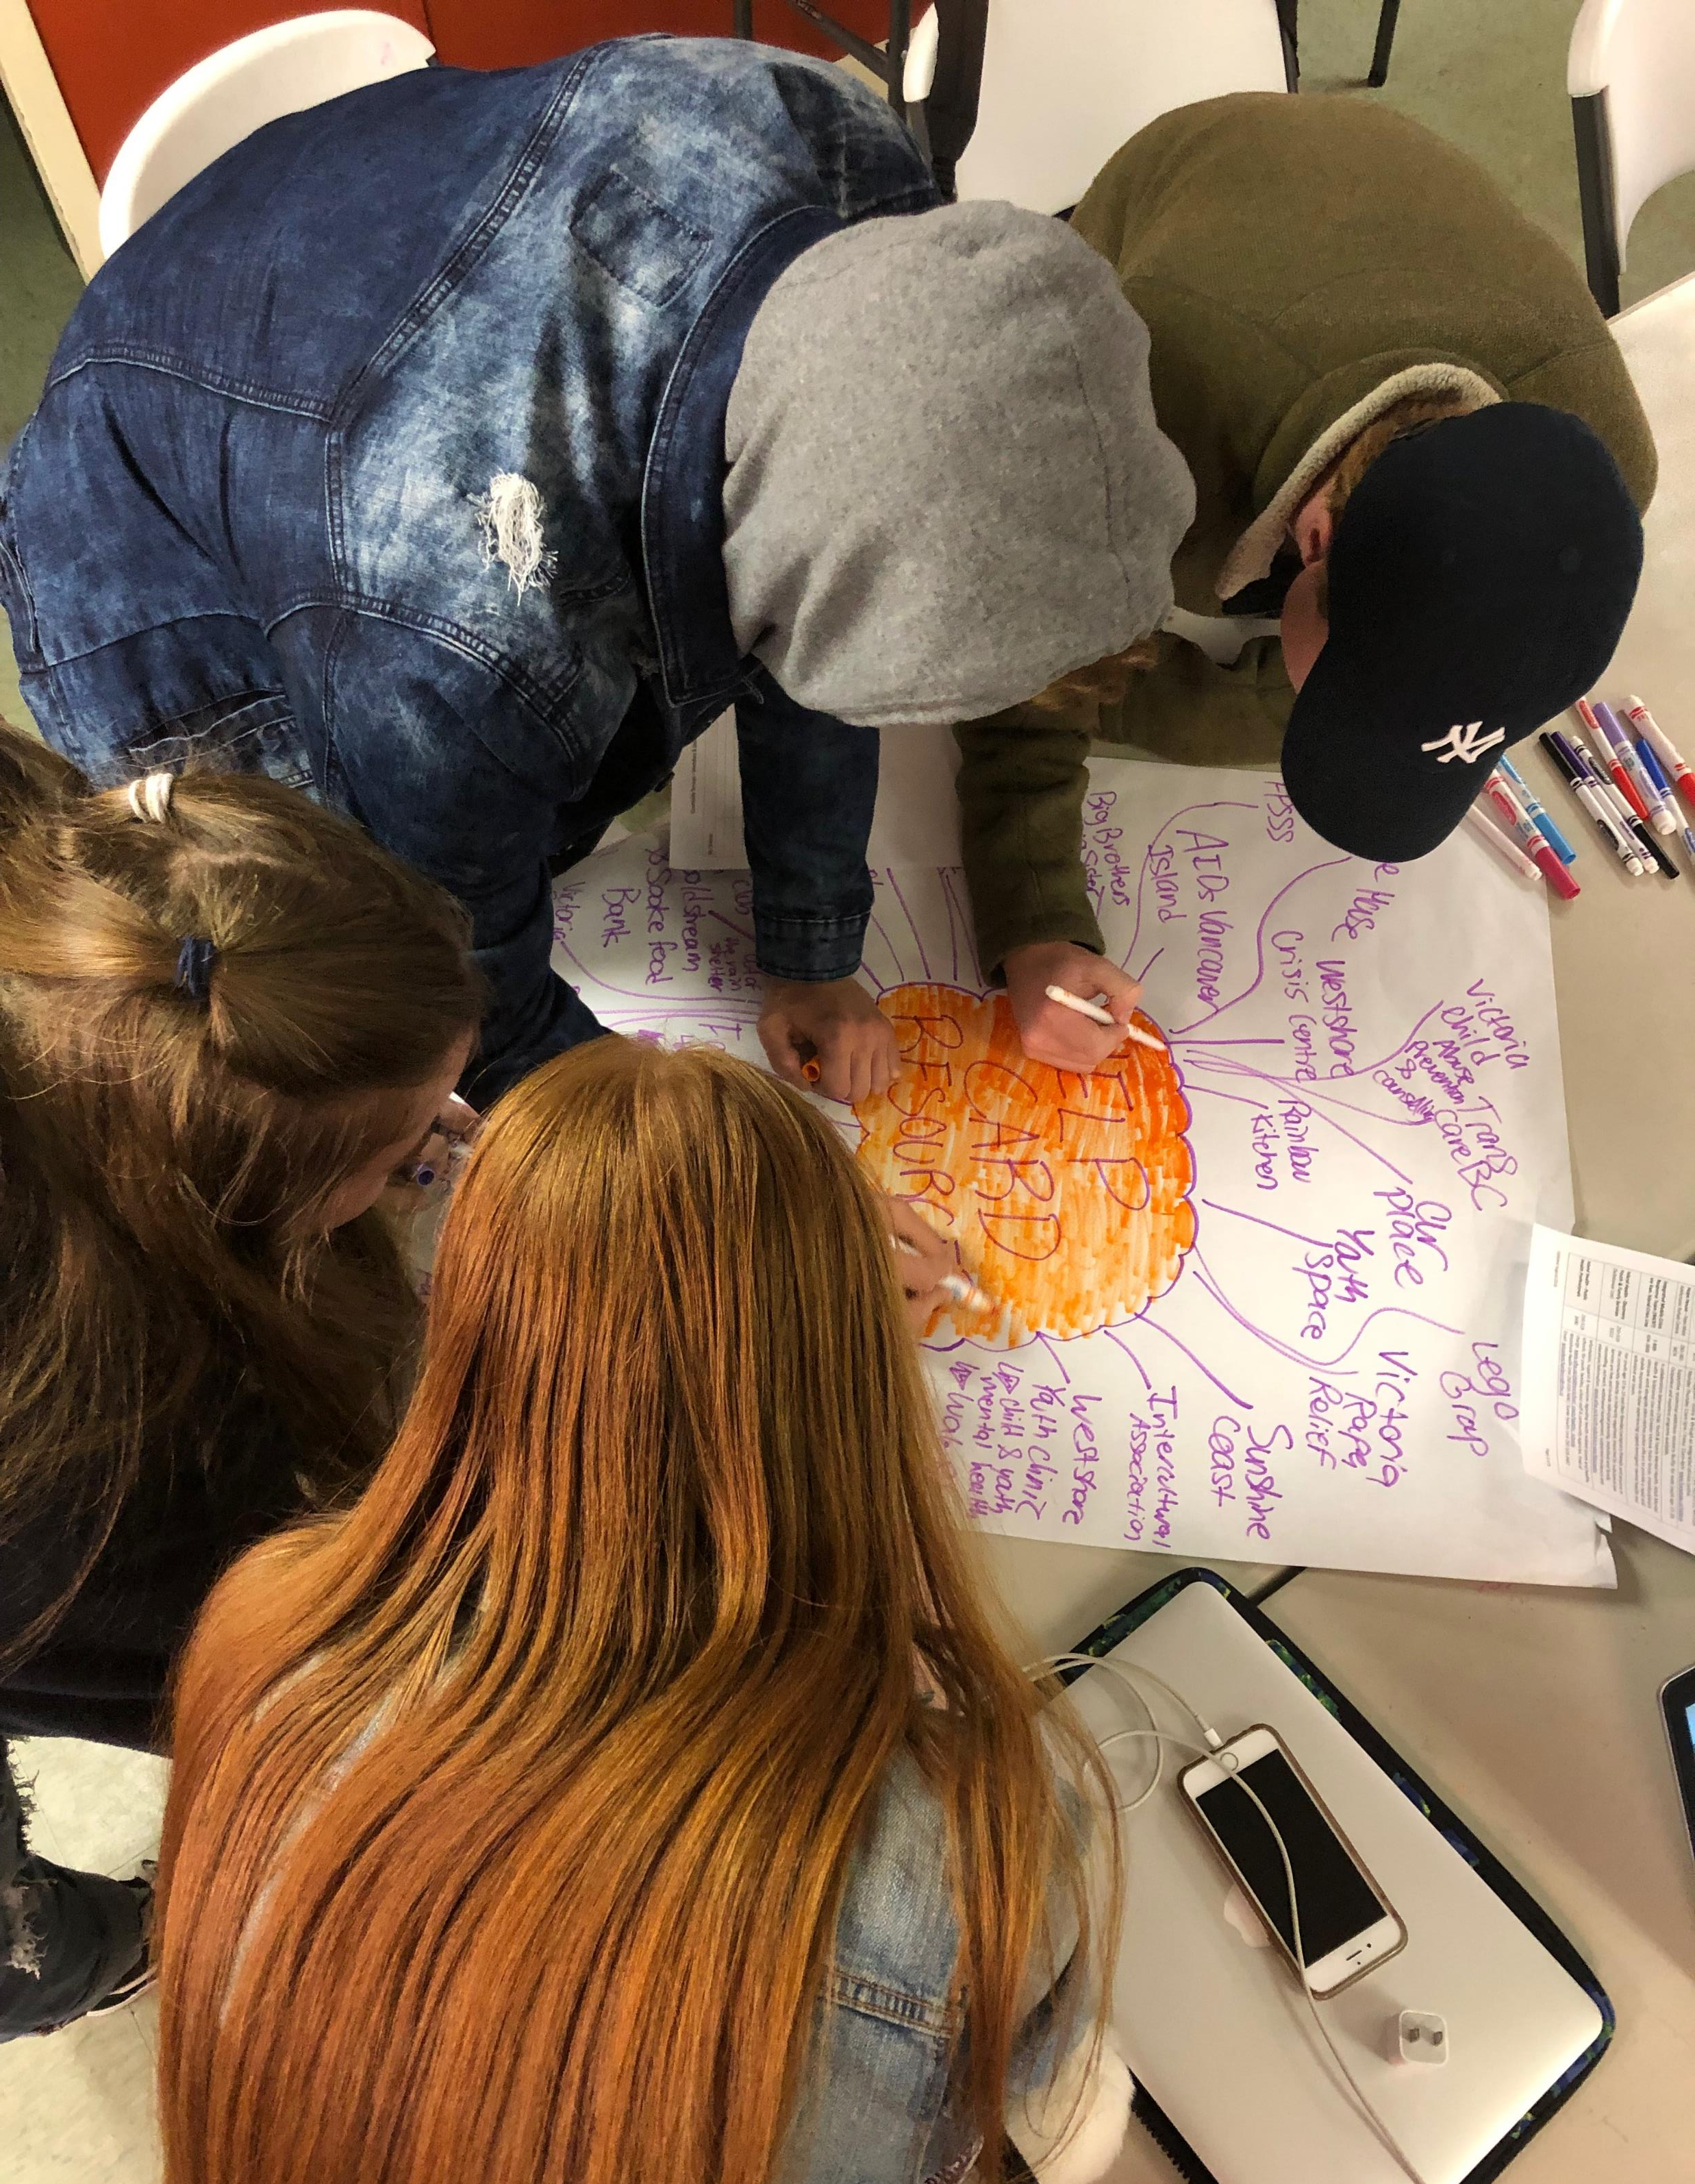
Momentum & Milestones
Relationships forged; trust built
Data-informed engagement & decision making
Joint funding pursuits and cost sharing
Synergies optimized
Shared use of space
Support for front line service providers (CoP, joint professional learning opportunities)
Youth in Action – on issues that matter to them
Regional, collaborative approach to Foundry Pursuit

Slide 7
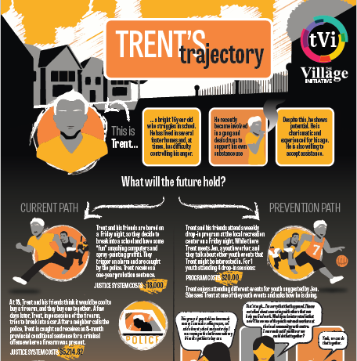
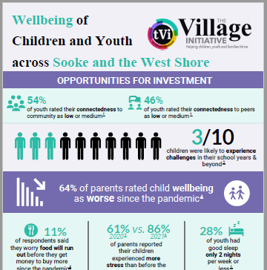
Notes:
Some examples related to helping support data-informed decision making.
Both graphics are online at www.thevillageinitiative.ca.

Slide 8
Foundry Expansion Opportunity
If I had a choice, I wouldn’t have to repeat my traumas multiple times to get the help I need.
- Young person speaking to the challenges of having to retell their story.
Prevention oriented interventions targeted to young people 12-24 have the capacity to generate greater person, social, and economic benefits than intervention at any time in the life span.
- Foundry BC
Notes:
Foundry is a province-wide network of integrated health and wellness services for young people ages 12-24. There are currently 16 Foundries across BC with 9 more in development. Funding for an additional 12 was announced September 6th with an application deadline of November 7th with decisions to be announced in March 2024.
Thrive (formerly Phoenix Human Services) applied as the lead agency for Foundry West Shore/Sooke along with supporting agencies of The Village Initiative (“TVI”).
Foundries consist of a team of youth-focused professionals that includes doctors, nurses, counsellors, youth workers, peer support workers, parent support workers, wellness navigators and administrative staff. A Foundry offers integrated services that make it possible for youth to access five core services in one convenient location: mental health care, substance use services, physical and sexual health care, youth and family peer supports, and social services. These services are provided by the Foundry and its network of partners. The goal is not to duplicate services, but to work with the existing services, add value and fill gaps.
More details about Foundry expansion are online at: https://foundrybc.ca/expansion/.
For more details related to the application for a Westshore/Sooke Foundry, please feel free to be in touch with Cindy Andrew at action@thevillageinitiative.ca.

Slide 9
Barriers Identified by Youth and Service Providers
Transportation options limited
Lack of language supports for newcomers
Cultural safety supports for Indigenous youth needed
Accessible services in short supply
Service fragmentation
Lack of access to primary care
Limited or no training/employment supports
Notes:
A sampling of what we’ve heard.

Slide 10

The Village Mobilized
Thrive Social Services Society: Lead Agency
Key community partners engaged
In-kind contributions identified
Tremendous community support including local Nations, municipalities, youth, parents, SD62
Hub and spoke model proposed
Notes:
The application process itself was very time limited. TVI network helped lay the foundation for an efficient, fulsome process that built a strong case for investment in a Foundry to serve 12-24 year olds and families across the Westshore/Sooke region.

Slide 11

RESULTS ARE COMING SOON!
Notes:
https://www.youtube.com/watch?v=UFck34SnyF8 – short video that shares more about this longitudinal survey of gr. 7-12 BC youth.
For more about AHS visit: https://mcs.bc.ca/ahs
TVI will be hosting a community wide forum to share the results – and in doing so will be engaging SD62 students. Stay tuned for more via www.thevillageinitiative.ca/events.

Slide 12

The importance of having sustained coordinated efforts cannot be under stated.

Slide 13

Questions?
Thank you – and keep in Touch!
action@thevillageinitiative.ca
M: 250-686-9209

