Slide 1
How to reduce homelessness, drug and alcohol abuse, crime and poverty while saving money
Bill Warburton
Presentation to Victoria Youth Justice & Family Court
October 26, 2023
Notes:
My message today is simple. It is possible to reduce social issues including poverty while reducing costs to the taxpayer.

Slide 2
I acknowledge with respect the Lək̓ʷəŋən speaking peoples on whose unceded traditional territory I have lived and worked for the past 40+ years, represented today by the Songhees and Esquimalt Nations.
Notes:
Our first finding is that We can identify 2000 10-year-olds who are at extreme risk of poor educational attainment.

Slide 3
Agenda
Results from our study
  Result 1: We can identify 2000 10-year-olds who are at extreme risk of poor educational attainment.
  Result 2: homelessness, drug and alcohol abuse, crime and poverty are primarily manifest among those who have dropped out of school.
From the literature
  There are interventions that are effective and cost-effective
  When interventions are subjected to independent scientific evaluations, most don’t work
  Success elsewhere doesn’t guarantee success in BC
Conclusion
  Try a lot, have independent, rigorous studies of their effectiveness; expand the ones that work.
Notes:
I will begin with two sets of facts that the Basic Income Study uncovered. The first is that each year we can identify 2,000 10-year-old children without an intellectual disability, autism or a severe physical disability, who are, nonetheless, at extreme risk of dropping out of school. The second is that the majority of social issues: homelessness, crime, drug abuse and income assistance are manifest among those who have not completed high school.
We are all familiar, I think, with the well-publicized studies of interventions that reduce social issues while saving the taxpayer money. For example, Nobel Prize winning, University of Chicago economics professor James Heckman reports that the Abcedarian intervention for disadvantaged children returned more than $6 for each $1 invested.
I asked one of our cabinet ministers why we don’t implement more programs like Abcedarian to reduce social issues. He pointed to the issue of social trust. To make such an investment, the government is asking voters to put their money upfront and trust that this government program will be so effective that they will get their money back and more plus interest over the next 60 years.
Research by the OECD and many others reports that the needed trust in government isn’t there.
Fortunately, public trust of scientists remains high so it may be possible to generate the requisite trust in these important investments by commissioning, independent scientific evaluations of new initiatives.
Before I get into what I mean by independent scientific evaluations and why I think that they are essential, let’s go over what we found.

Slide 4
We can identify 2000 10-year-olds who are at extreme risk of poor educational attainment.
Notes:
Our first finding is that We can identify 2000 10-year-olds who are at extreme risk of poor educational attainment.

Slide 5
Sample: 1999/2000 to 2005/2006 (about 250,000 students)
  Less some special needs, those who entered or left the province
Hold the 2002/2003 class separate
Characteristics:
  Foundation Skills Assessment scores,
  Special needs codes
  Income Assistance history
  Use of the health care system
  Family structure and stability
  Contact with the Ministry for Children and Family Development
Linear probability model
Notes:
The administrative data also allowed us to follow the roughly 250,000 students, born in BC, and in grade 4 between 1999/2000 and 2005/2006 through the education system to graduation. The sample was restricted to kids who had not been classified as having an intellectual disability, severe physical disability or ASD.
We used 6 years of data to identify the characteristics that predicted graduation and the 7th year to test the predictions.

Slide 6
Of the 2,000 10-year-olds at extreme risk each year
69% did not graduate high school
Only 1% graduated on time with an average or better GPA
Notes:
We found that we can identify 2,000 children at age 10, who are at extreme risk of poor educational outcomes. Of these 2,000 children 1,380 will not graduate and only 20 will graduate on time with at least an average GPA.

Slide 7
Homelessness, drug and alcohol abuse, crime and poverty are primarily manifest among those who have not completed high school.
Notes:
The second thing that we found was that social issues are. Also using administrative data we followed over a million students through the BC education system and into adulthood.

Slide 8
Grade 12 Graduation
Notes:
¾ of students in our sample graduated although as we will see, graduates who took English 12 do much better than students who took the easier Communications 12.
Let’s see how they turned out.

Slide 9
Income assistance (as a proxy for poverty)
20% of females who didn’t make it to grade 12 received IA in any given month
77%
of total
Relative risk ~30
Relative risk almost 10
Notes:
This graph shows the percentage who received IA in any given month by how well they did in HS. in any given month 20% of females who didn’t make it to grade 12 received IA after turning 19, compared with less than 1% of females who graduated on time with an average GPA. People in public health like to talk about relative risk. The risk of receiving IA for a person who did not make it to grade 12 is 30 times the risk for a person who graduated on time with English 12 and at least an average gpa.
There are differences among grads too. Those who graduated with Communications 12 received about twice as much IA as those who graduated late, with a low GPA but with English 12 and about 10 times as much IA as those who graduated on time with English 12 and a better than average GPA.
¾ of all IA paid out, was paid to students who had not graduated.

Slide 10
Homelessness
82%
of total
Relative risk ~60
Relative risk ~ 10
Notes:
The remaining social issues paint a similar picture, so I will go through them quickly.
Here is homelessness. Those who didn’t make it to grade 12 were 60 times more likely to be homeless in 2017. Non-completers accounted for 82% of homeless

Slide 11
Corrections
75%
of total
Relative risk ~40
Relative risk ~ 10
Notes:
Those who didn’t make it to grade 12 were 40 times more likely to be known to corrections. Non-completers accounted for 75% of those known to corrections

Slide 12
Prescriptions related to drug and alcohol treatment
77%
of total
Relative risk ~40
Relative risk ~ 7
Notes:
Those who didn’t make it to grade 12 were 40 times more likely to have a prescription related to drug and alcohol abuse. Non-completers accounted for 75% of those with a prescription related to drug and alcohol abuse

Slide 13
Having a child in care
90%
of total
Relative risk ~200
Relative risk ~ 23
Notes:
Women who didn’t make it to grade 12 were 200 times more likely to have a child in care. Non-completers accounted for 90% of women who had a child in care

Slide 14
Taxes paid and high school graduation
Net present value of difference is
$75,000
Notes:
I want to add one more outcome. Thanks to Scott, Statistics Canada linked BC’s education data to tax data, so we could see how kids did after leaving school. This graph shows the taxes paid by students who were in grade 11 in 1991/1992, the first year of the data. Clearly grads pay a lot more taxes. Assuming that the difference persists until age 65 and is zero thereafter, the net present value of the difference discounted to age 18 is around $75,000.

Slide 15
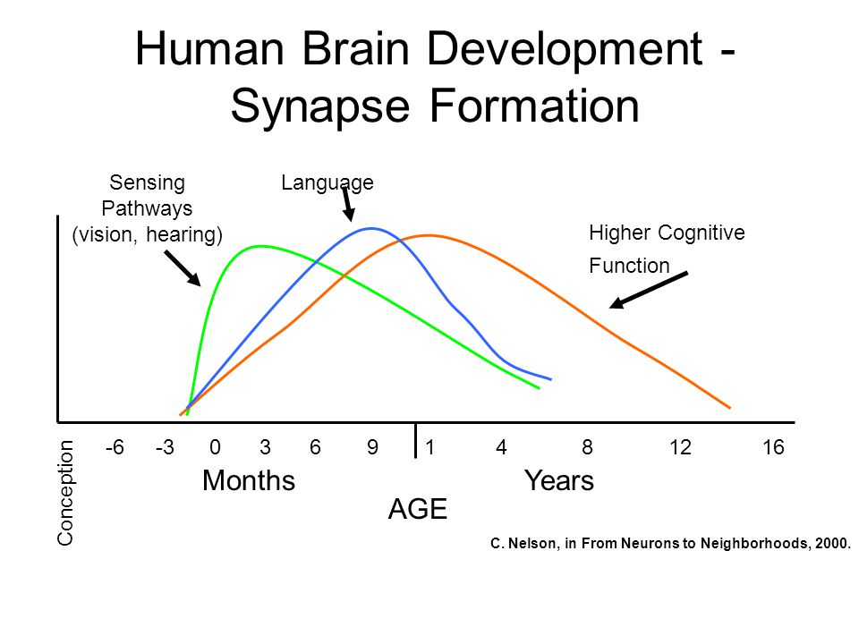
“Early pathways, though far from indelible, establish either a sturdy or fragile stage on which subsequent development is constructed.”
National Research Council. 2000.

Slide 16
Three interventions that that are effective and cost-effective
Notes:
The second thing that we found was that social issues are. Also using administrative data we followed over a million students through the BC education system and into adulthood.

Slide 17
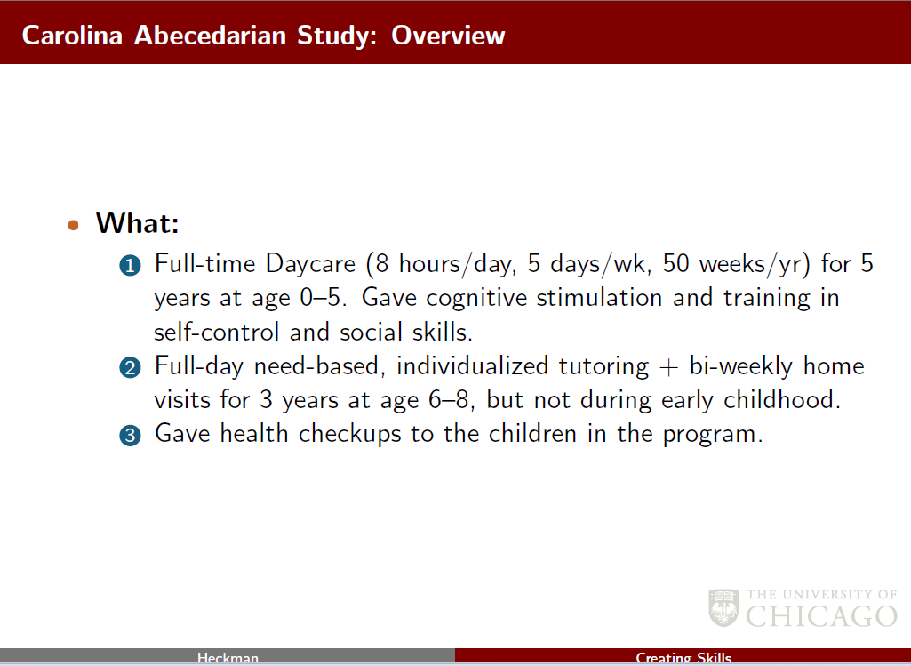

Slide 18
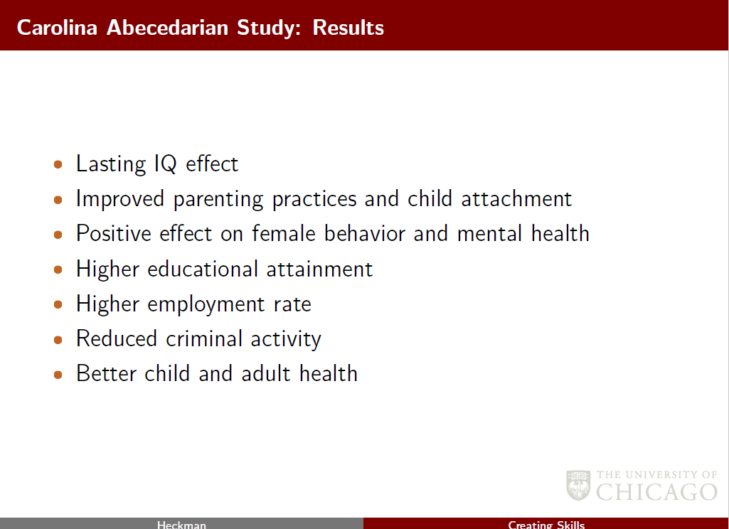
$6.30 return to society for each $1 invested
Notes:
Sara B. Heller, Anuj K. Shah, Jonathan Guryan, Jens Ludwig, Sendhil Mullainathan, Harold A. Pollack, Thinking, Fast and Slow? Some Field Experiments to Reduce Crime and Dropout in Chicago, The Quarterly Journal of Economics, Volume 132, Issue 1, February 2017, Pages 1–54, https://doi.org/10.1093/qje/qjw033

Slide 19
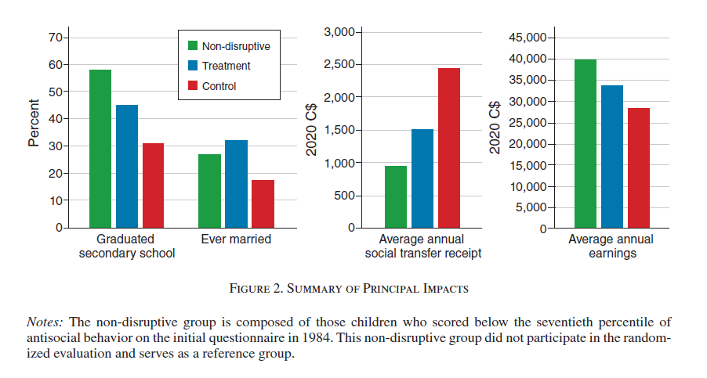
Childhood Social Skills and Self-Control Training

Slide 20
Thinking Fast, Thinking Slow
Project Summary
Male high school students in economically disadvantaged areas of Chicago were offered group sessions during the school day to learn how to slow down their decision-making in high-stakes situations.
Impact
Participation in the program reduced total arrests by 28-35%, violent-crime arrests by 45–50%, and increased high school graduation by 19%.
Cost
At the time of the study, the intervention cost was estimated to be approximately $1,850 per participant per year, at scale.

Slide 21
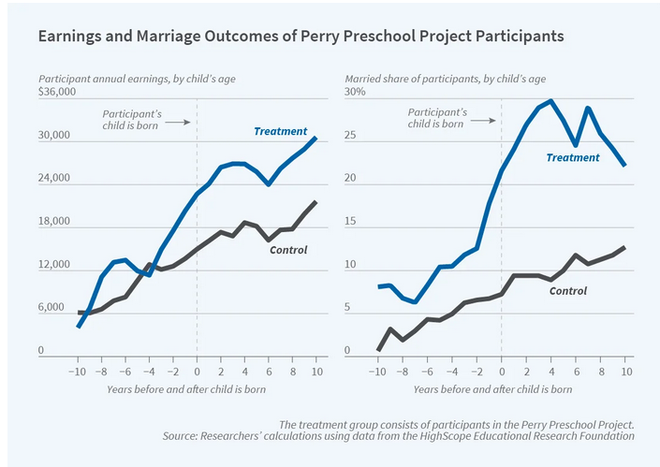
The children of treatment group (average age 28) are
more likely to be in good health
more likely to be employed,
less likely to have been suspended from school
less likely to be divorced.
https://hceconomics.uchicago.edu/news/research-spotlight-lasting-benefits-perry-preschool-participants-siblings-and-children https://www.nber.org/papers/w29057

Slide 22
Trust
Notes:
I talked about the need for independent scientific evaluations.

Slide 23
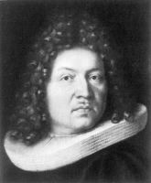
Random Assignment
The average value of any variable will be the same for the sample as for the population, provided that the sample is selected randomly. 1689
Jacob Bernoulli
Notes:
By scientific, I mean evaluations that estimate the impact of the interventions using random assignment. Random assignment is the only method that can be proved mathematically to generate unbiased estimates of program impact. It has been required for the testing of all new drugs and medical devices for more than 50 years. It is common in science—the BC Cancer Agency has enrolled more than 34,000 patients in randomized trials.

Slide 24
Most new ideas are wrong
  50-80% of new drugs fail when subjected to randomized controlled trials (RCT’s)
  80-90% of new products/strategies conducted by Google and Microsoft have no significant effects when tested in RCT’s
  70% to 80% of new social interventions subjected to scientific evaluation in the US did not achieve their objectives
Different impacts in different sites
  JTPA Impacts on youth
  Nurse Family Partnership
  Pre-K
Notes:
Where random assignment is used, the unpleasant truth, that most new ideas are wrong, is revealed. For example, 50-80% of positive results in initial clinical studies of new drugs (so called Phase II trials) are overturned in subsequent, more rigorous Randomized phase III trials.
Random assignment is rare in social services, but where it is used, for social programs a similar pattern emerges. The US Evidence-Based Policymaking Commission reports that 70% to 80% of new social interventions subjected to scientific evaluation did not achieve their objectives.
Those who wish to implement effective social interventions face an additional challenge—the legal and social framework, the nature of disadvantage of the program participants and the content of the intervention can all vary from site to site. As a result, the “same program” can have different effects in different sites.
And a lot of the literature comes from the US which has a very different the legal and social framework
Finally, conflicts of interest can bias even rigorous studies. This is so widely recognized that authors must include a conflict-of-interest statement with submissions to almost all academic journals. But here in BC, we ask each Ministry and often each program manager to report on the effectiveness of their own programs.

Slide 25
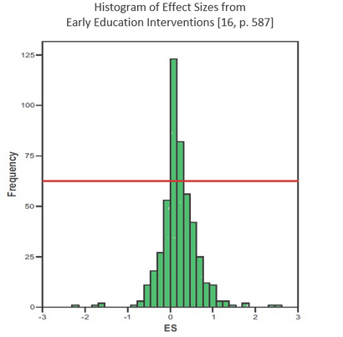
Interventions that are effective and cost-effective
Scared Straight,(Petrosino et al. 2013)
McCord, Joan. 2003. “Cures That Harm
Tennessee’s pre-kindergarten (Lipsey, Farran, and Hofer 2015)
Disruptive kids Tremblay AER 2022
Universal pre-K Boston Gray-Lobe 2022
Abcedarian The Lifecycle Benefits of an Influential Early Childhood Program. Heckman et al

Slide 26
Public trust
48%
38%

Slide 27
Summary

Slide 28
Summary
Results from our study
  Result 1: We can identify 2000 10-year-olds who are at extreme risk of poor educational attainment.
  Result 2: homelessness, drug and alcohol abuse, crime and poverty are primarily manifest among those who have dropped out of school.
From the literature
  There are interventions that are effective and cost-effective
  When interventions are subjected to independent scientific evaluations, most don’t work
  Success elsewhere doesn’t guarantee success in BC
Conclusion
  Try a lot, have independent, rigorous studies of their effectiveness; expand the ones that work. Our society can be healthier, wealthier and happier.
Notes:
I will begin with two sets of facts that the Basic Income Study uncovered. The first is that each year we can identify 2,000 10-year-old children without an intellectual disability, autism or a severe physical disability, who are, nonetheless, at extreme risk of dropping out of school. The second is that the majority of social issues: homelessness, crime, drug abuse and income assistance are manifest among those who have not completed high school.
We are all familiar, I think, with the well-publicized studies of interventions that reduce social issues while saving the taxpayer money. For example, Nobel Prize winning, University of Chicago economics professor James Heckman reports that the Abcedarian intervention for disadvantaged children returned more than $6 for each $1 invested.
I asked one of our cabinet ministers why we don’t implement more programs like Abcedarian to reduce social issues. He pointed to the issue of social trust. To make such an investment, the government is asking voters to put their money upfront and trust that this government program will be so effective that they will get their money back and more plus interest over the next 60 years.
Research by the OECD and many others reports that the needed trust in government isn’t there.
Fortunately, public trust of scientists remains high so it may be possible to generate the requisite trust in these important investments by commissioning, independent scientific evaluations of new initiatives.
Before I get into what I mean by independent scientific evaluations and why I think that they are essential, let’s go over what we found.

Slide 29
Conclusion
We can move towards a better society by
implementing rigorous evaluations of existing programs,
introducing new programs with rigorous evaluation built in,
independent reporting,
expanding the programs that work and
re-thinking or re-tooling the ones that don’t.
Notes:
In summary, most social issues are manifest among those who have poor educational outcomes. In BC we can now identify about 2,000 10-year-olds who are at extreme risk of poor educational outcomes each year. Ignoring the plight of these children will cost us plenty. Scientific research has shown that it is possible to deflect disadvantaged children onto healthier, happier trajectories. But we and the voters can only know that these investments are paying off if we conduct rigorous independent evaluations of the interventions as they are implemented here in BC.
We can take concrete steps to a better society by implementing rigorous evaluations of existing programs, by introducing new programs with rigorous evaluation built in, by expanding the programs that work and by re-thinking or re-tooling the ones that don’t.

